Slide 1
Unit 6
Teacher: iddo sadeh

Slide 2
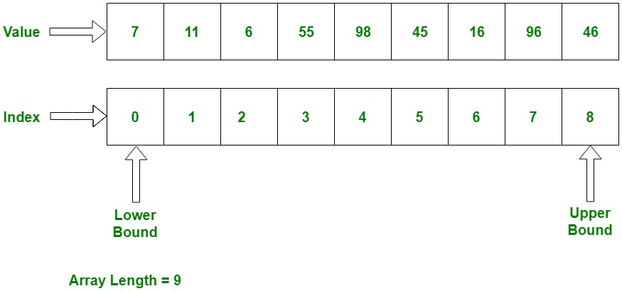
arrays
Block of memory that stores a collection of data items (elements)
Useful whenever you have many elements of data of the same type that you want to keep track of, but you don’t need to name each one.
* Picture taken from https://www.geeksforgeeks.org/c-sharp-arrays/

Slide 3
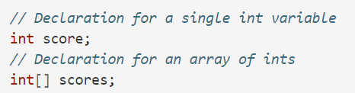
Declaring arrays
* Screenshot from https://csawesome.runestone.academy/runestone/books/published/csawesome/Unit6-Arrays/topic-6-1-array-basics.html
Notes:
When we declare a variable, we specify its type and then the variable name. To make a variable into an array, we put square brackets after the data type. For example, int[] scores means we have an array called scores that contains int values.

Slide 4
Creating arrays
https://www.youtube.com/watch?v=IbPFjw1FNkE&feature=emb_logo
Notes:
The declarations do not create the array. Arrays are objects in Java, so any variable that declares an array holds a reference to an object. If the array hasn’t been created yet and you try to print the value of the variable, it will print null (meaning it doesn’t reference any object yet).

Slide 5
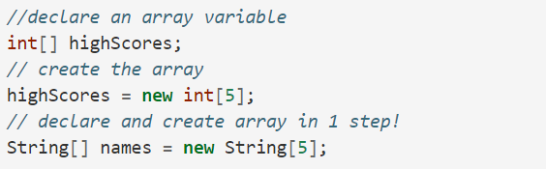
Declaring and creating an array in one step
* Screenshot from https://csawesome.runestone.academy/runestone/books/published/csawesome/Unit6-Arrays/topic-6-1-array-basics.html
Notes:
First method is with new

Slide 6
Notes:
Second way is with initializer list
Note: the size of an array can not be modified (like in python).

Slide 7
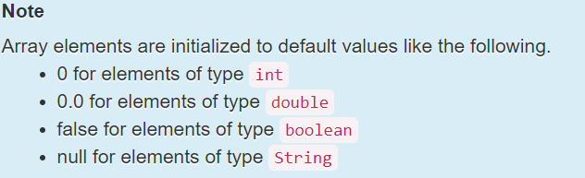
notes
You can use dot notation to find the length of an array (similar to using a length method in string class):
arrayName.length
* Screenshot from https://csawesome.runestone.academy/runestone/books/published/csawesome/Unit6-Arrays/topic-6-1-array-basics.html
Notes:
Note that length is an instance variable and not a method, unlike the String length() method, so you don’t add parentheses after length. However, if you use parentheses after length during the exam, you won’t lose any points. The length instance variable is declared as a public final int. public means you can access it and final means the value can’t change.

Slide 8
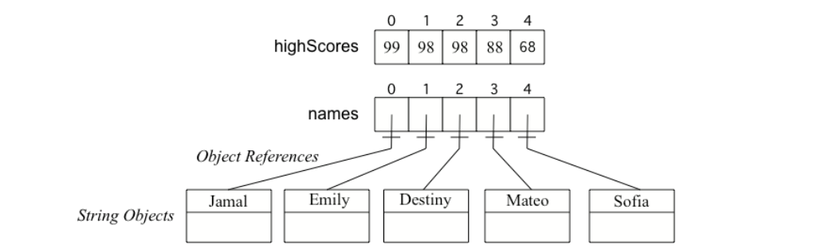
Arrays of objects vs primitive types
* Screenshot from https://csawesome.runestone.academy/runestone/books/published/csawesome/Unit6-Arrays/topic-6-1-array-basics.html

Slide 9
Accessing and modifying arrays
To access the elements in an array, we use an indexed array variable which is the array name and the index inside of square bracket [ ].
arrayName[index]
For example:
System.out.println(array[2]);
Or
int a=array[0];

Slide 10
Traversing arrays
You can use loops to traverse through arrays (go through all the elements).
To traverse from the last index to first index use arrayName.length – 1 as your initial index
Make sure to put in conditions in your for loop to avoid errors (traversing through indexes that are out of bounds)
Remember arrays start at the 0th index
Notes:
Off by one errors are common

Slide 11
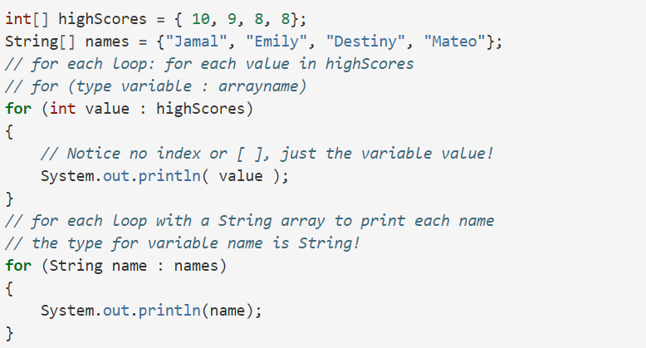
For each loop
* Screenshot from https://csawesome.runestone.academy/runestone/books/published/csawesome/Unit6-Arrays/topic-6-3-arrays-with-foreach.html
Notes:
To set up a for-each loop, use for (type variable : arrayname) where the type is the type for elements in the array, and read it as “for each variable value in arrayname”.

Slide 12
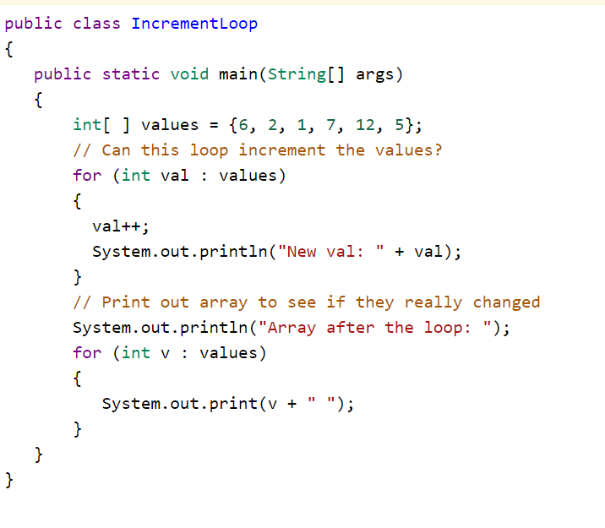
Notes:
Try out this code
https://csawesome.runestone.academy/runestone/books/published/csawesome/Unit6-Arrays/topic-6-3-arrays-with-foreach.html

Slide 13
Array summary
Arrays represent collections of related data all of the same data type.
The size of an array is established at the time of creation and cannot be changed.
Arrays can store either primitive data or object reference data.
When an array is created using the keyword new, all of its elements are initialized with a specific value based on the type of elements:
Elements of type int are initialized to 0
Elements of type double are initialized to 0.0
Elements of type boolean are initialized to false
Elements of a reference type are initialized to the reference value null. No objects are automatically created.
Initializer lists can be used to create and initialize arrays.
Square brackets ([ ]) are used to access and modify an element in an array using an index. The indexed array variable, for example array[index], can be used anywhere a regular variable can be used, for example to get or assign values.
The valid index values for an array are 0 through one less than the number of elements in the array, inclusive. Using an index value outside of this range will result in an ArrayIndexOutOfBoundsException being thrown.

